Slide 1

Mini project-1A/2A Project Title
Mr. Amit Santosh Nalawade (S.E /C/06)
Mr. Monu Vinod Shaha (S.E/C/34)
Mr.Chetan Ramesh Anekar (S.E/C/01)
Under the guidance of
Ms . Nikita Saindane
Department of Computer Engineering
Pillai HOC College of Engineering and Technology, Rasayani University of Mumbai
A.Y. 2024-25

Slide 2
Lifesavers Network: Hope in Drop

Slide 3
INDEX
▶ INTRODUTION
▶ OBJECTIVES
▶ PROBLEM STATEMENT
▶ EXITING SYSTEM
▶ PROPOSED SYSTEM
▶ ALGORITHM
▶ REQUIREMENTS
▶ REFERENCES
▶ CONCLUSION

Slide 4
INTRODUCTION
▶ Every year countless lives are saved due to blood donors yet the need for blood is constant and urgent.
▶ At Blood Donor Bridge, we believe in the power of community and the impact of a single donation.
▶ Our platform is designed to simplify the donation process and facilitate crucial connections.

Slide 5
OBJECTIVES
▶ Create a seamless platform which is easy to use and understand.
▶ Optimizing the website for quick loading and responsiveness.
▶ Promoting adherence to health and safety guidelines to ensure a safe donation experience for all users.

Slide 6
PROBLEM STATEMENT
▶ Donor finds it difficult to know whether he/she is eligible or not.
▶ There is lack of integrated system that provides information about available blood donors and their locations.
▶ There is lack of systems that keeps donors informed and involved.

Slide 7
EXISTING SYSTEM
▶ There are platforms like Red Cross and UBlood which tells donor about importance of donation.
▶ These platforms allow donors to register, schedule donation appointments and receive reminders.
▶ These websites help user to get real time updates.

Slide 8
PROPOSED SYSTEM
▶ Our website offers resources on the blood donation process, eligibility criteria,benefits and safety tips.
▶ Users can sign up and create profiles, including personal details, blood type.
▶ Providing a comprehensive FAQ section and support channels for user queries.

Slide 9
ALGORITHM
▶ START
▶ Sign up/Sign in
▶ Providing information to check whether user is eligible or not.
▶ How much blood user can donate.(If eligible)
▶ What care should be taken after blood donation.
▶ Showing next donation date.
▶ EXIT

Slide 10
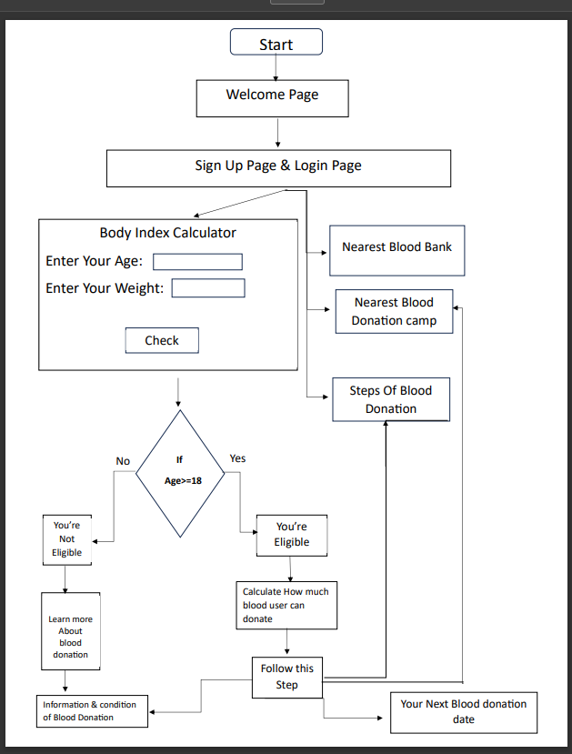

Slide 11
REQUIREMENTS
▶ Frontend
HTML
CSS
▶ Backend
Java Script

Slide 12
REFERENCES
▶ https://copyassignment.com/blood
-bank-management-system-project- in-java/
▶ https://youtu.be/t- a7bIgbMKg?si=yPSjtCrD_-wOon9F

Slide 13
CONCLUSION
▶ The Blood Donor Bridge website will play a crucial role in transforming blood donation processes,making them more efficient.
▶ The platform will strengthen the global network of blood donors and recipents.
▶ It will help donor to get more knowledge in less time.

Slide 14
THANK YOU

